Slide 1
Stone,
Campbell,
Scott,
O’Kelly,
Mulkey.

Slide 2
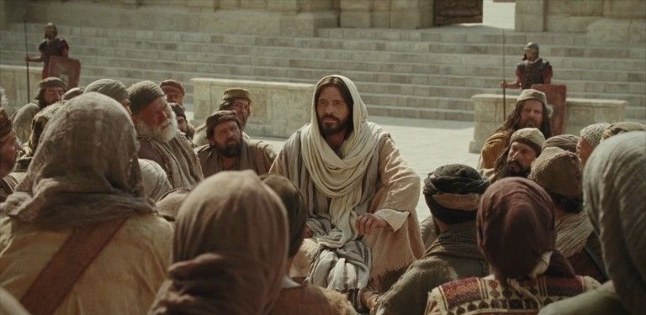
A Promise from Jesus
And I also say to you that you are Peter, and on this rock I will build My church, and the gates of Hades shall not prevail against it.
Matthew 16:18

Slide 3
What was wrecked ?
What was restored?
The Lord’s church existed in the 1st Century, Matt 16:18; Ac 2:46.
And local churches were established & functioning at that time, Ac 14:23; Phil 1:1; Rom 16:16; 1 Cor 16:1-2.

Slide 4
RESTORATION

Slide 5
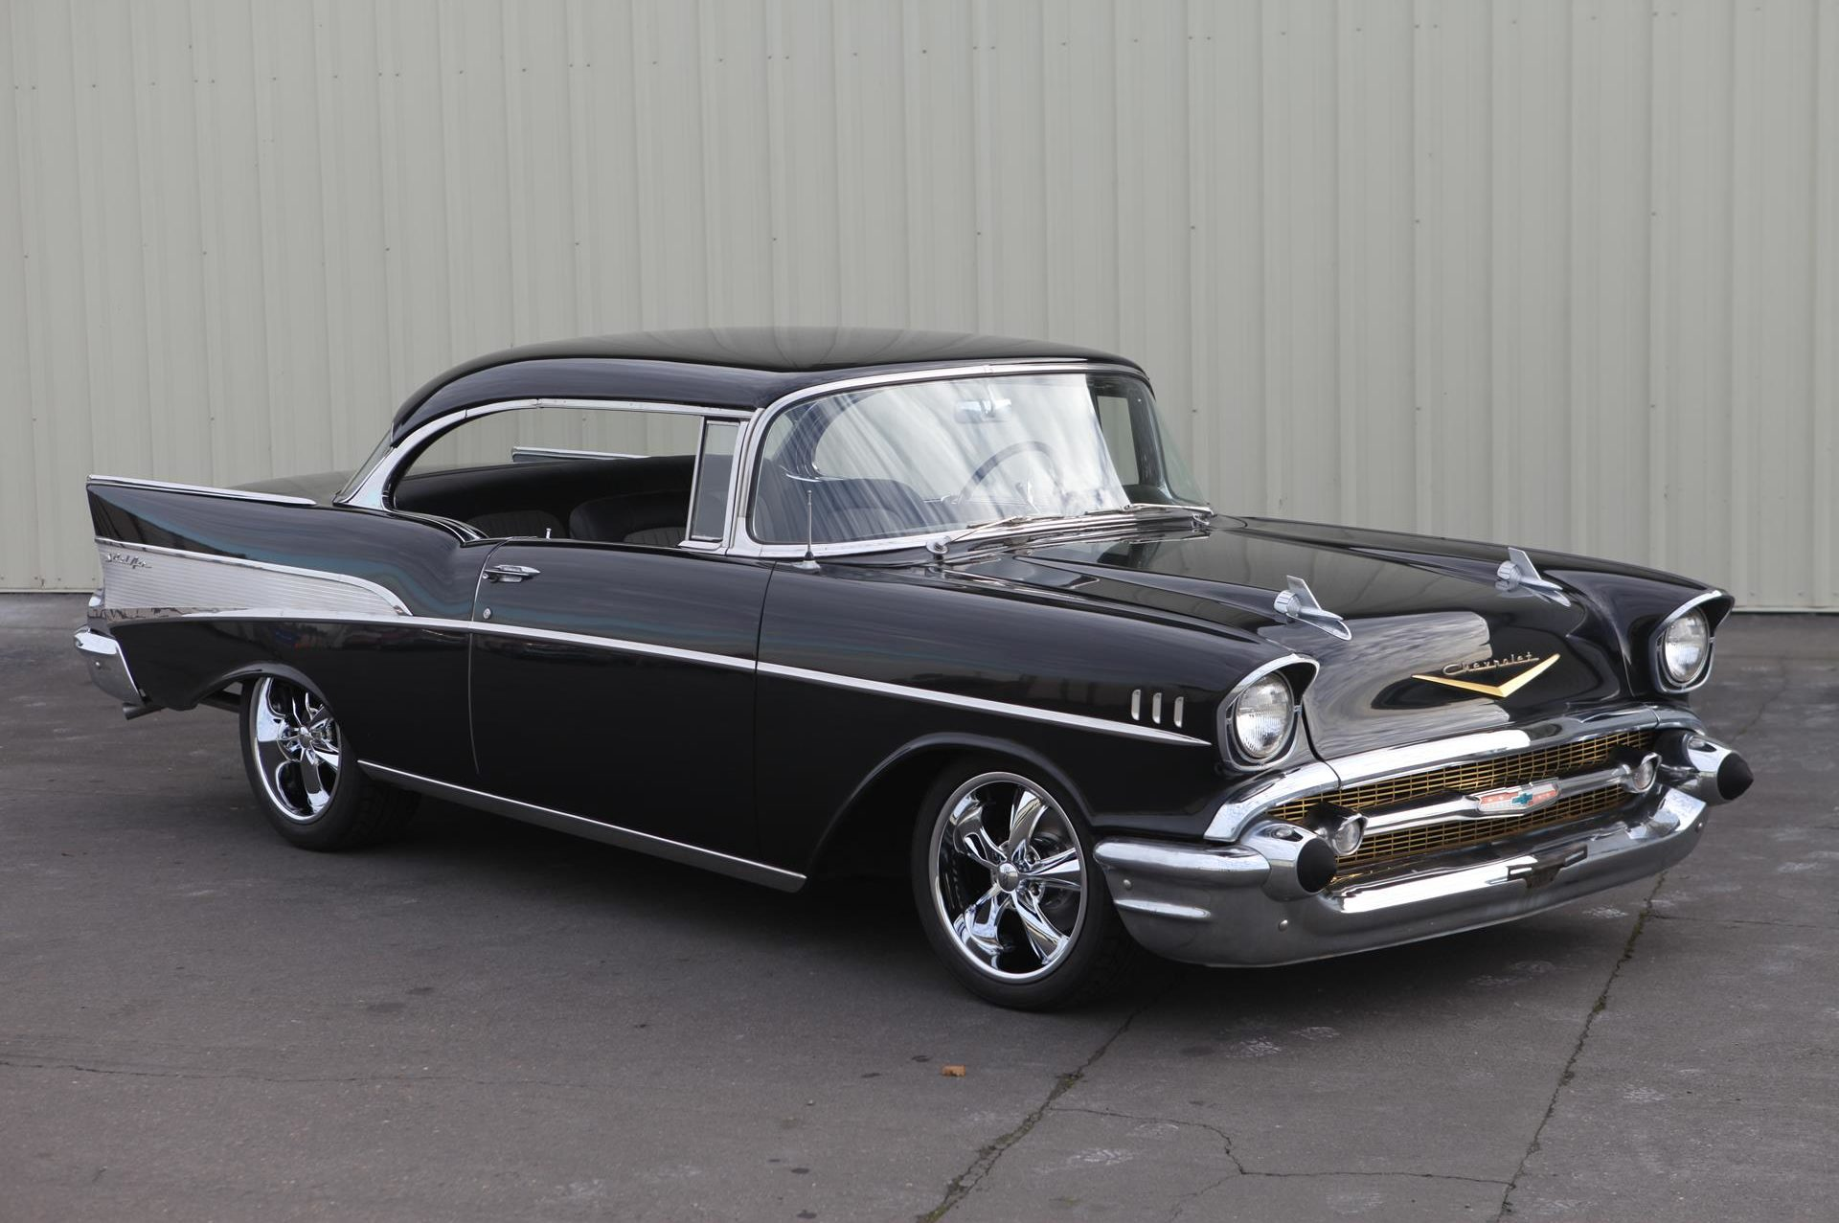
RESTORATION

Slide 6
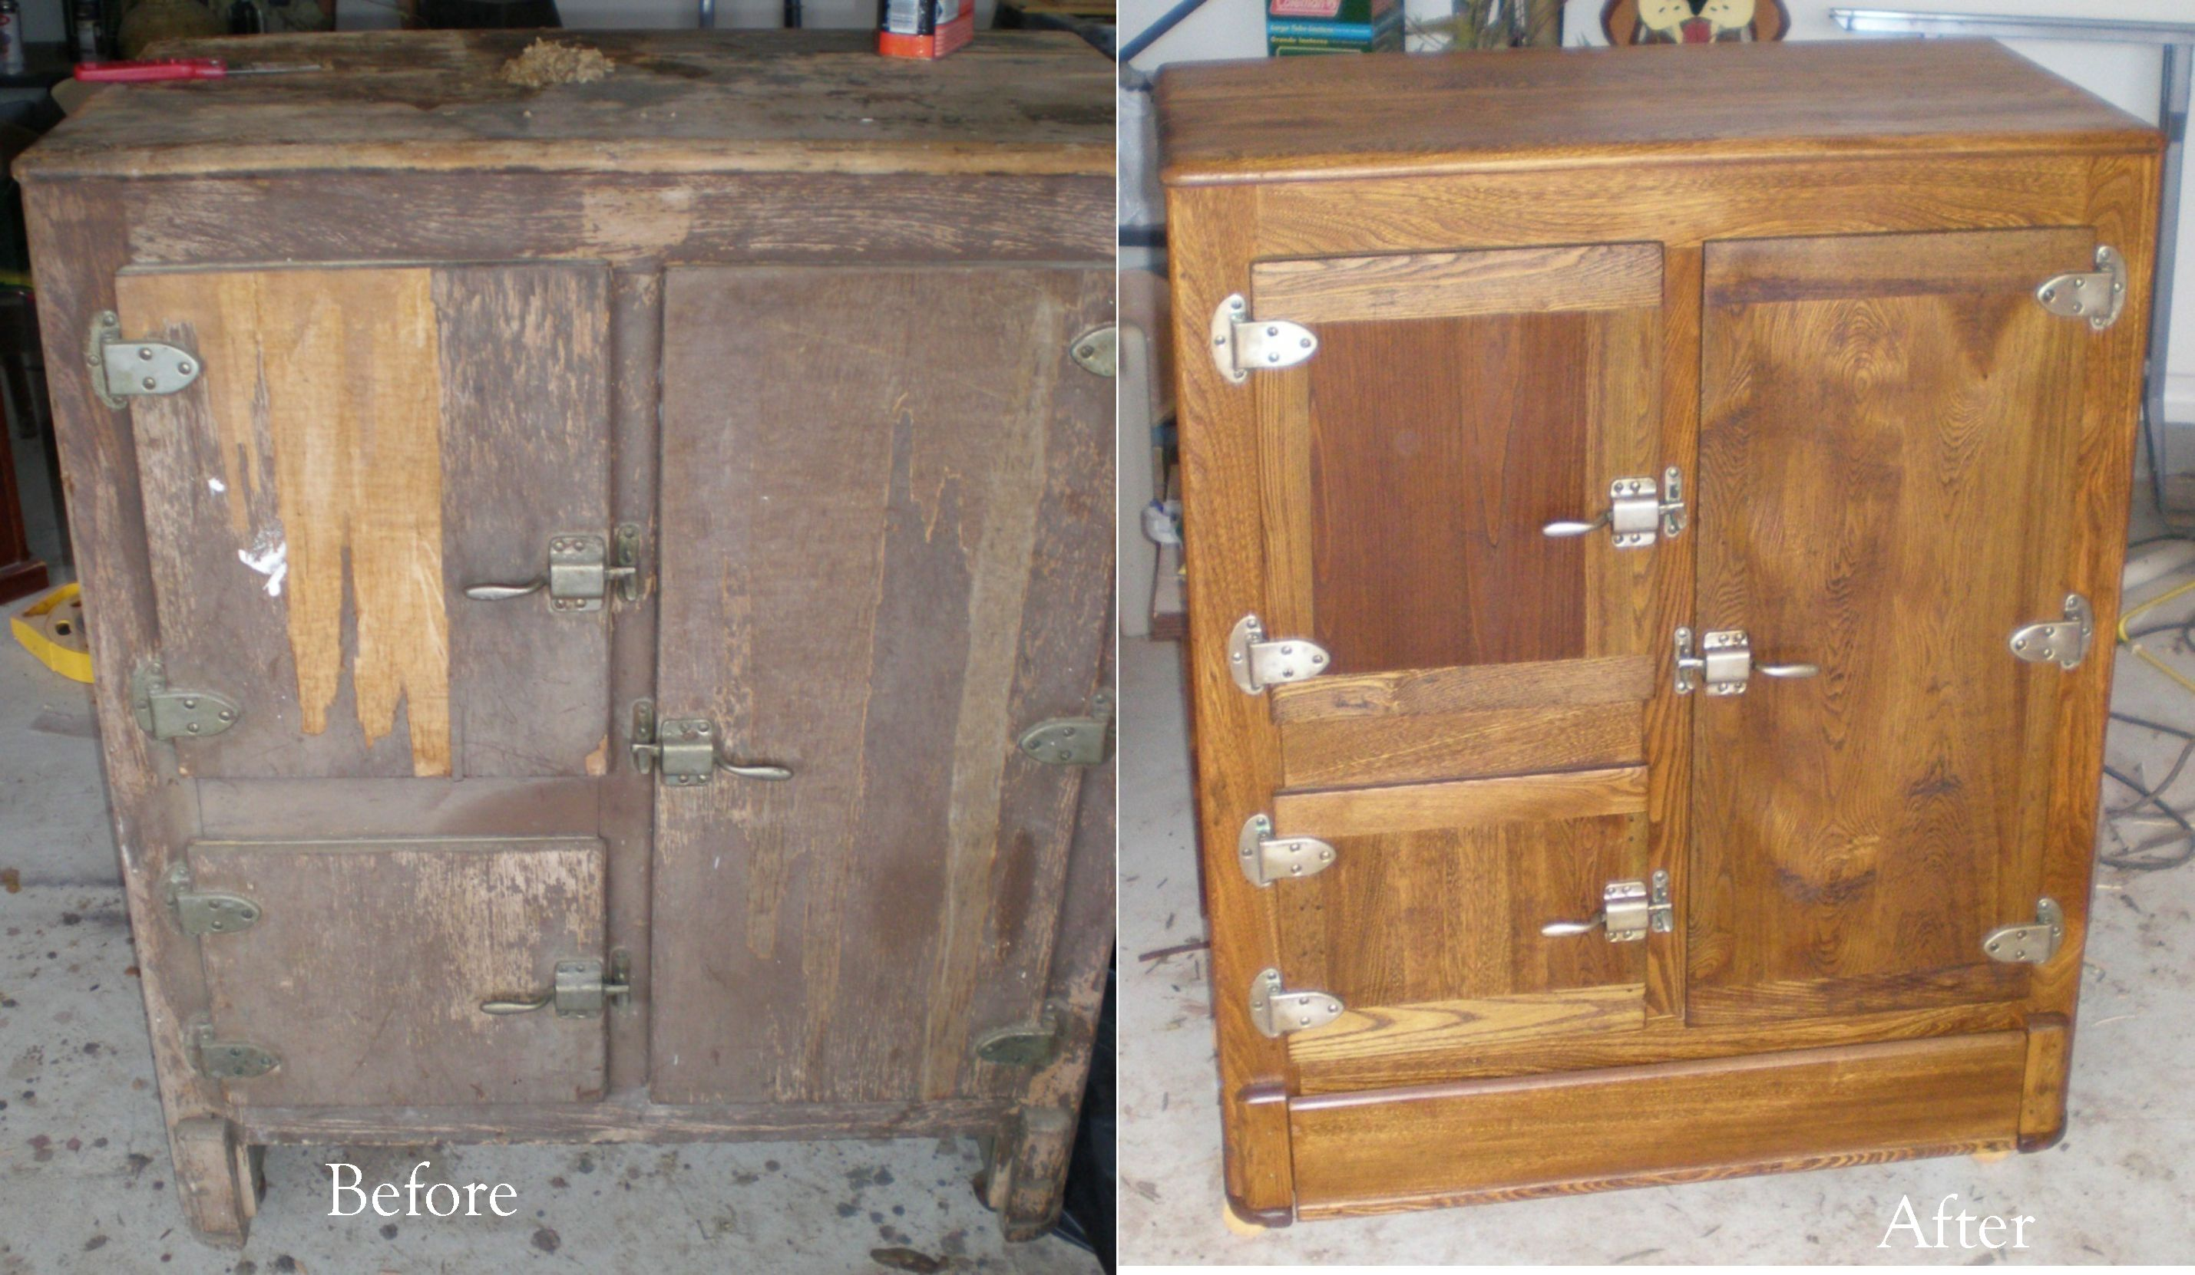
RESTORATION

Slide 7
No support of human institution
Prayers
Name
Organization
Baptism
Lord’s Supper
Preaching
Bible classes
Collection
Singing

Slide 9
Christians have failed to restore Moral Distinctiveness.
Churches are now replacing a heavenly focus with a focus upon the world.
Christians have failed to restore time needed to devote to the Great Commission.
Churches are now no longer God-Centered, but have become me-centered.

